Slide 1

Welcome! Thank you for being here this morning!
Bridging the Cultural Divide will start at 9:00 AM.
Please make sure you are on mute when we start.

Slide 2

Welcome & a few requests …
Have on hand a piece of paper and pen/pencil to do the exercises
Keep your cameras on
Please mute yourself
Participate in the breakout groups

Slide 3
Welcome from UWF El Camino Real President Debbie Ow

Slide 4
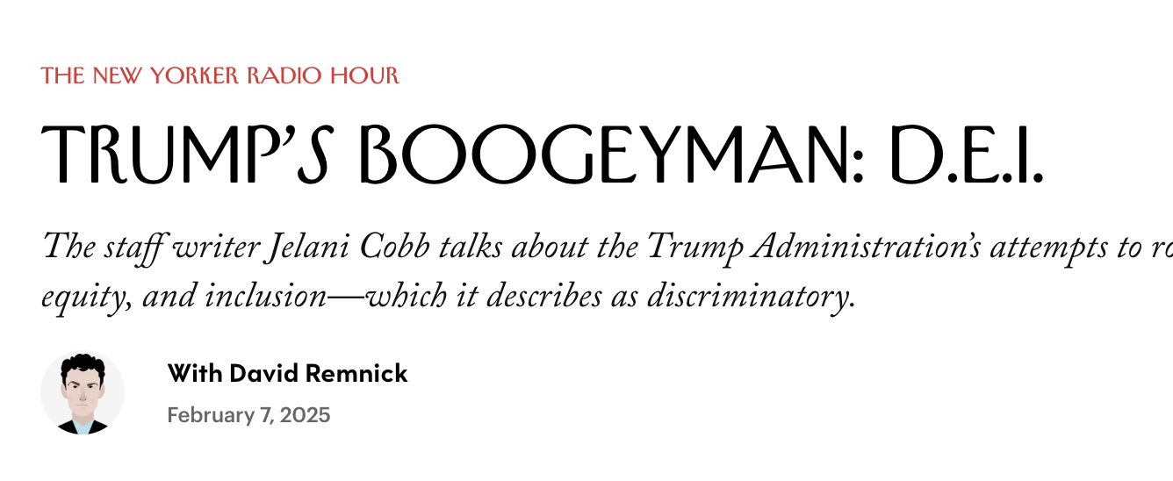
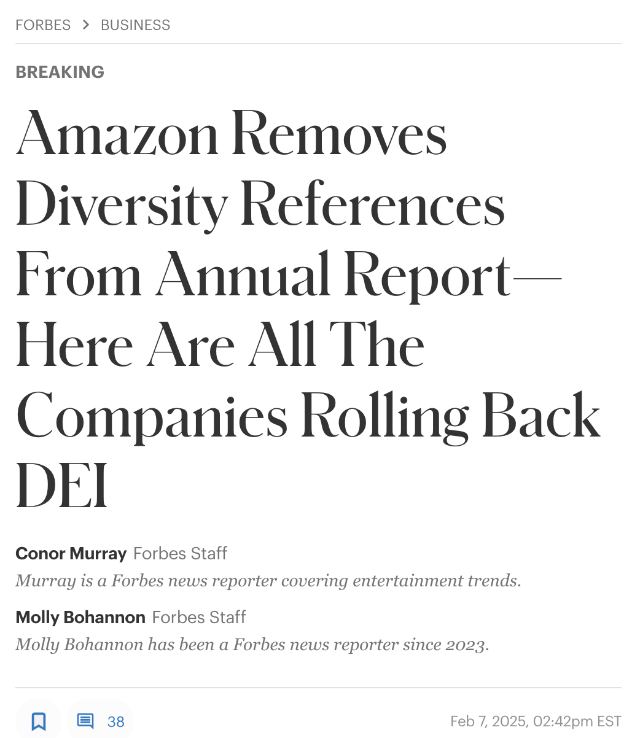
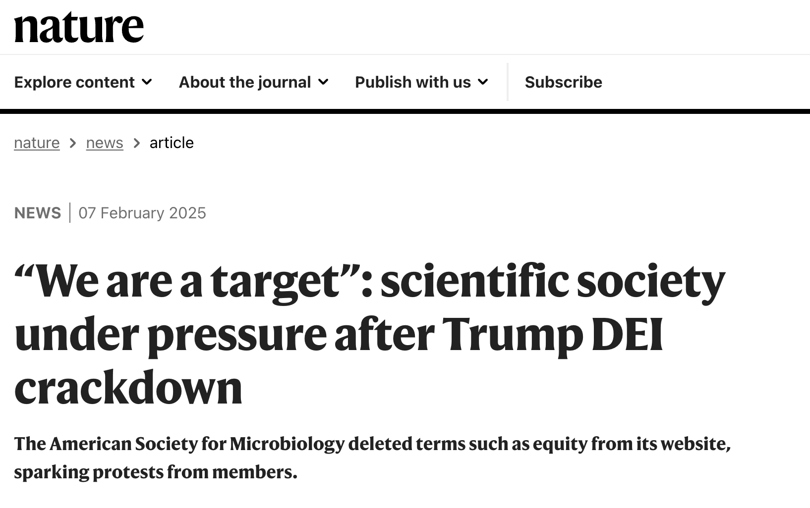
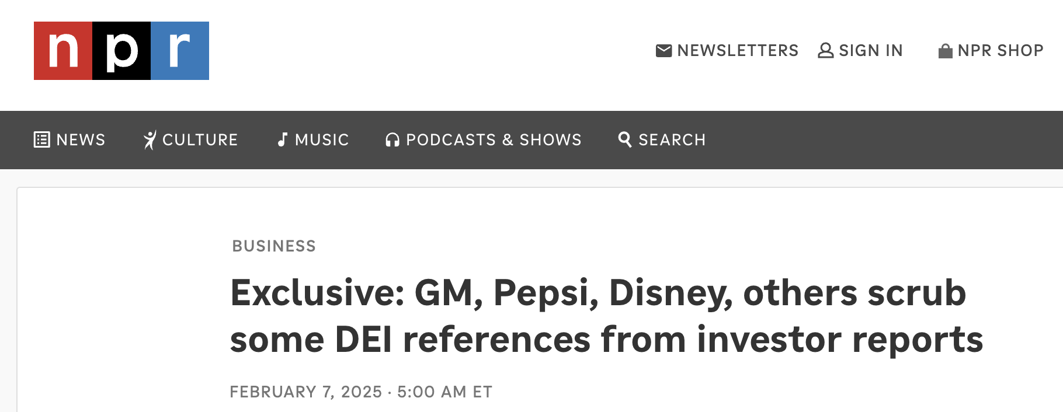
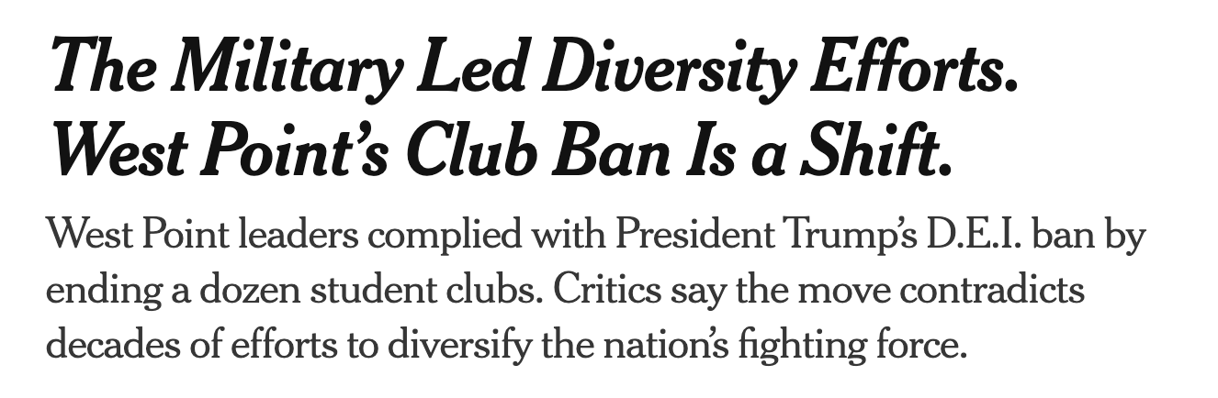
Notes:
Good morning and welcome. My name is Mary Cheng, director of Leadership Development for the conference. Thank you for joining us for this workshop, Cultural Humility and Agility: Exploring mindsets and skillsets for intercultural relationships. We are excited you are here and thank you for making this investment of time to learn together.
.

Slide 5
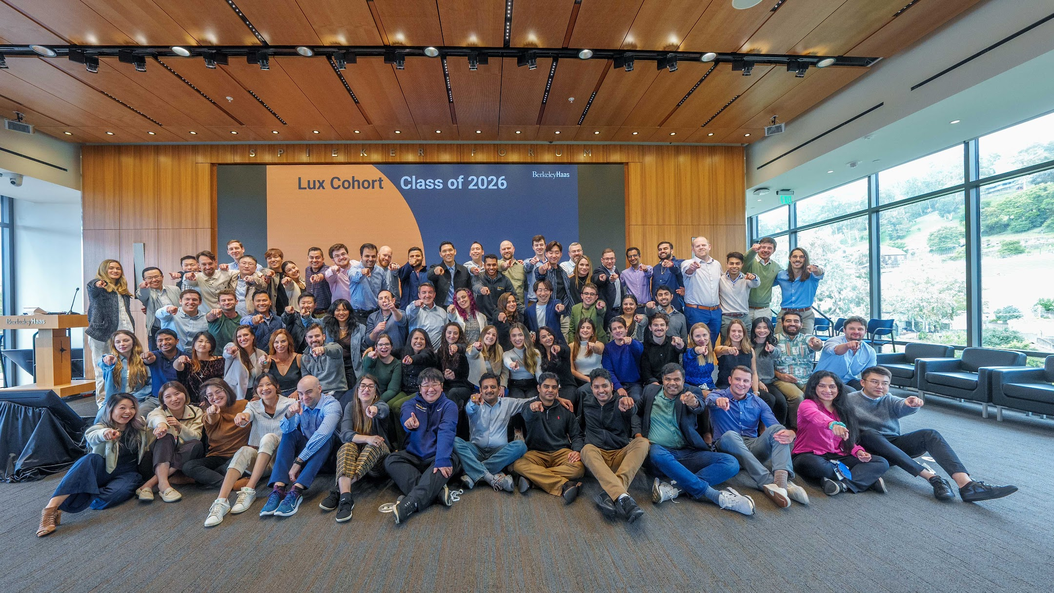
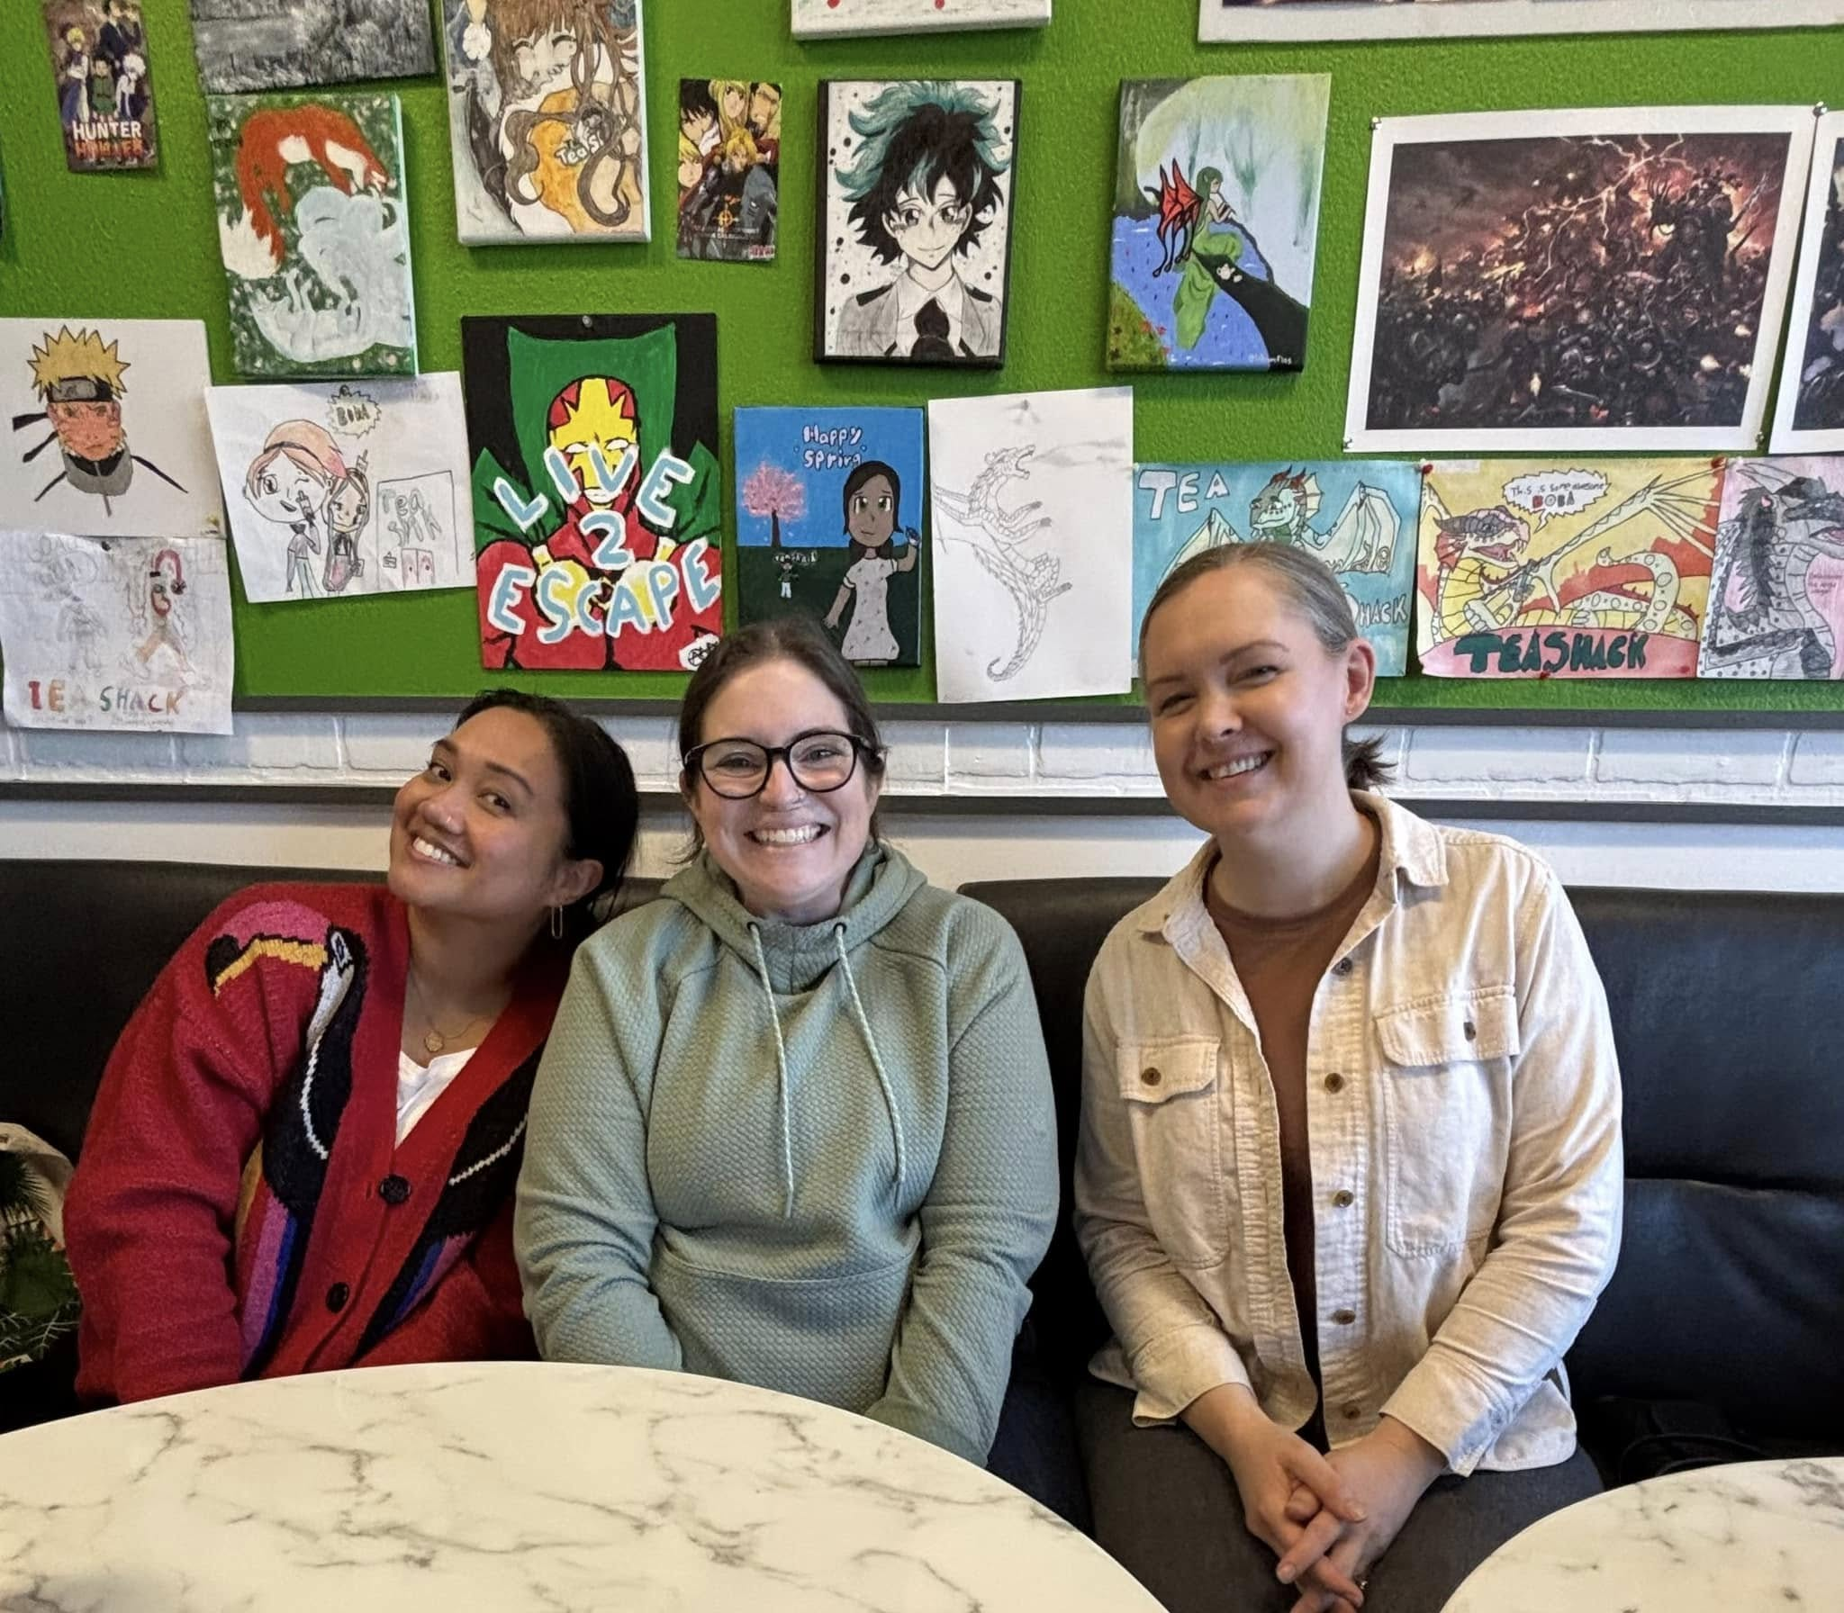
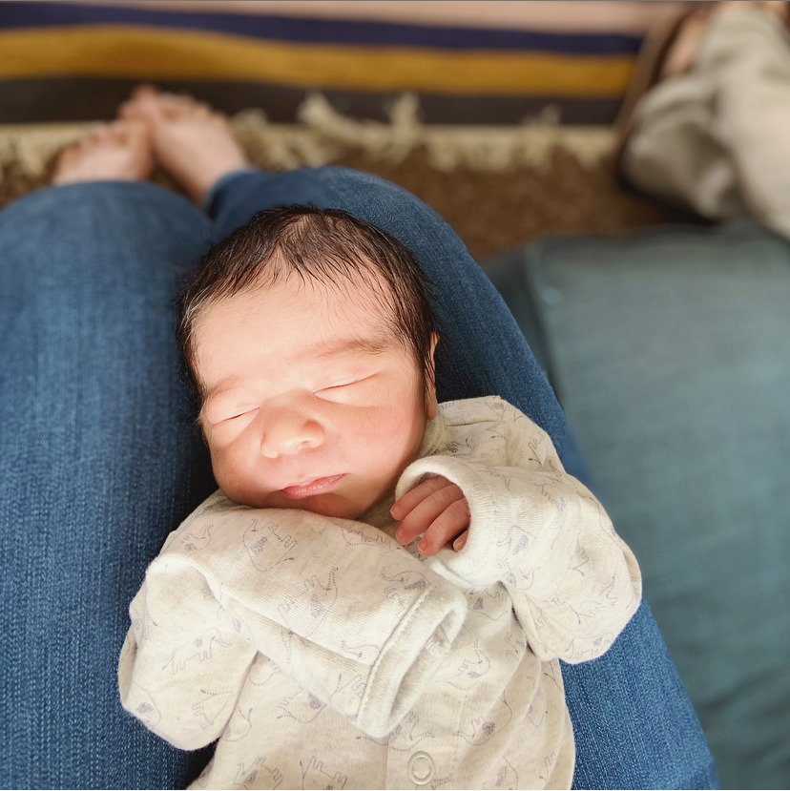
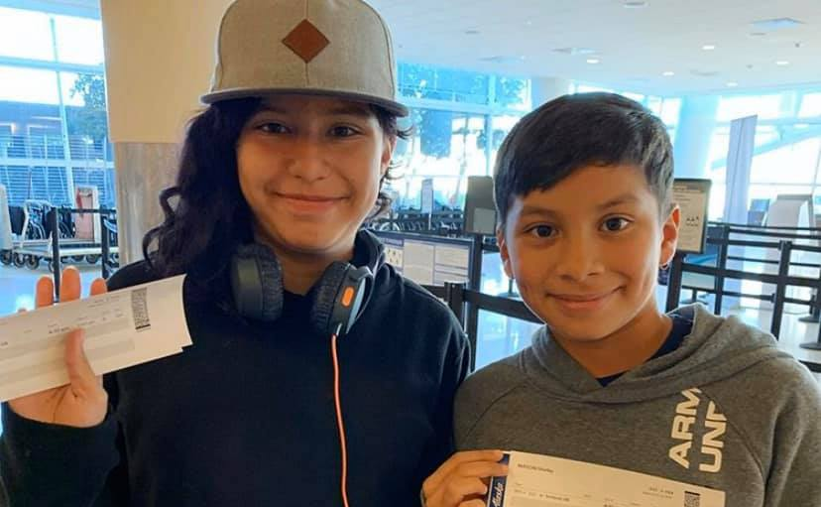
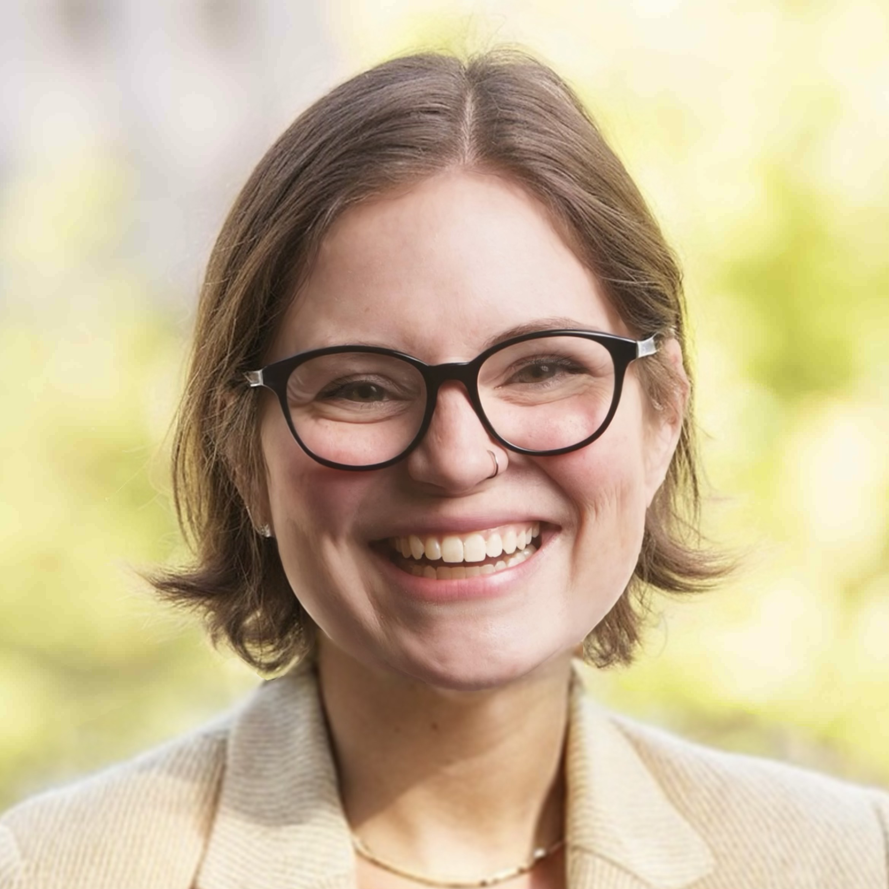
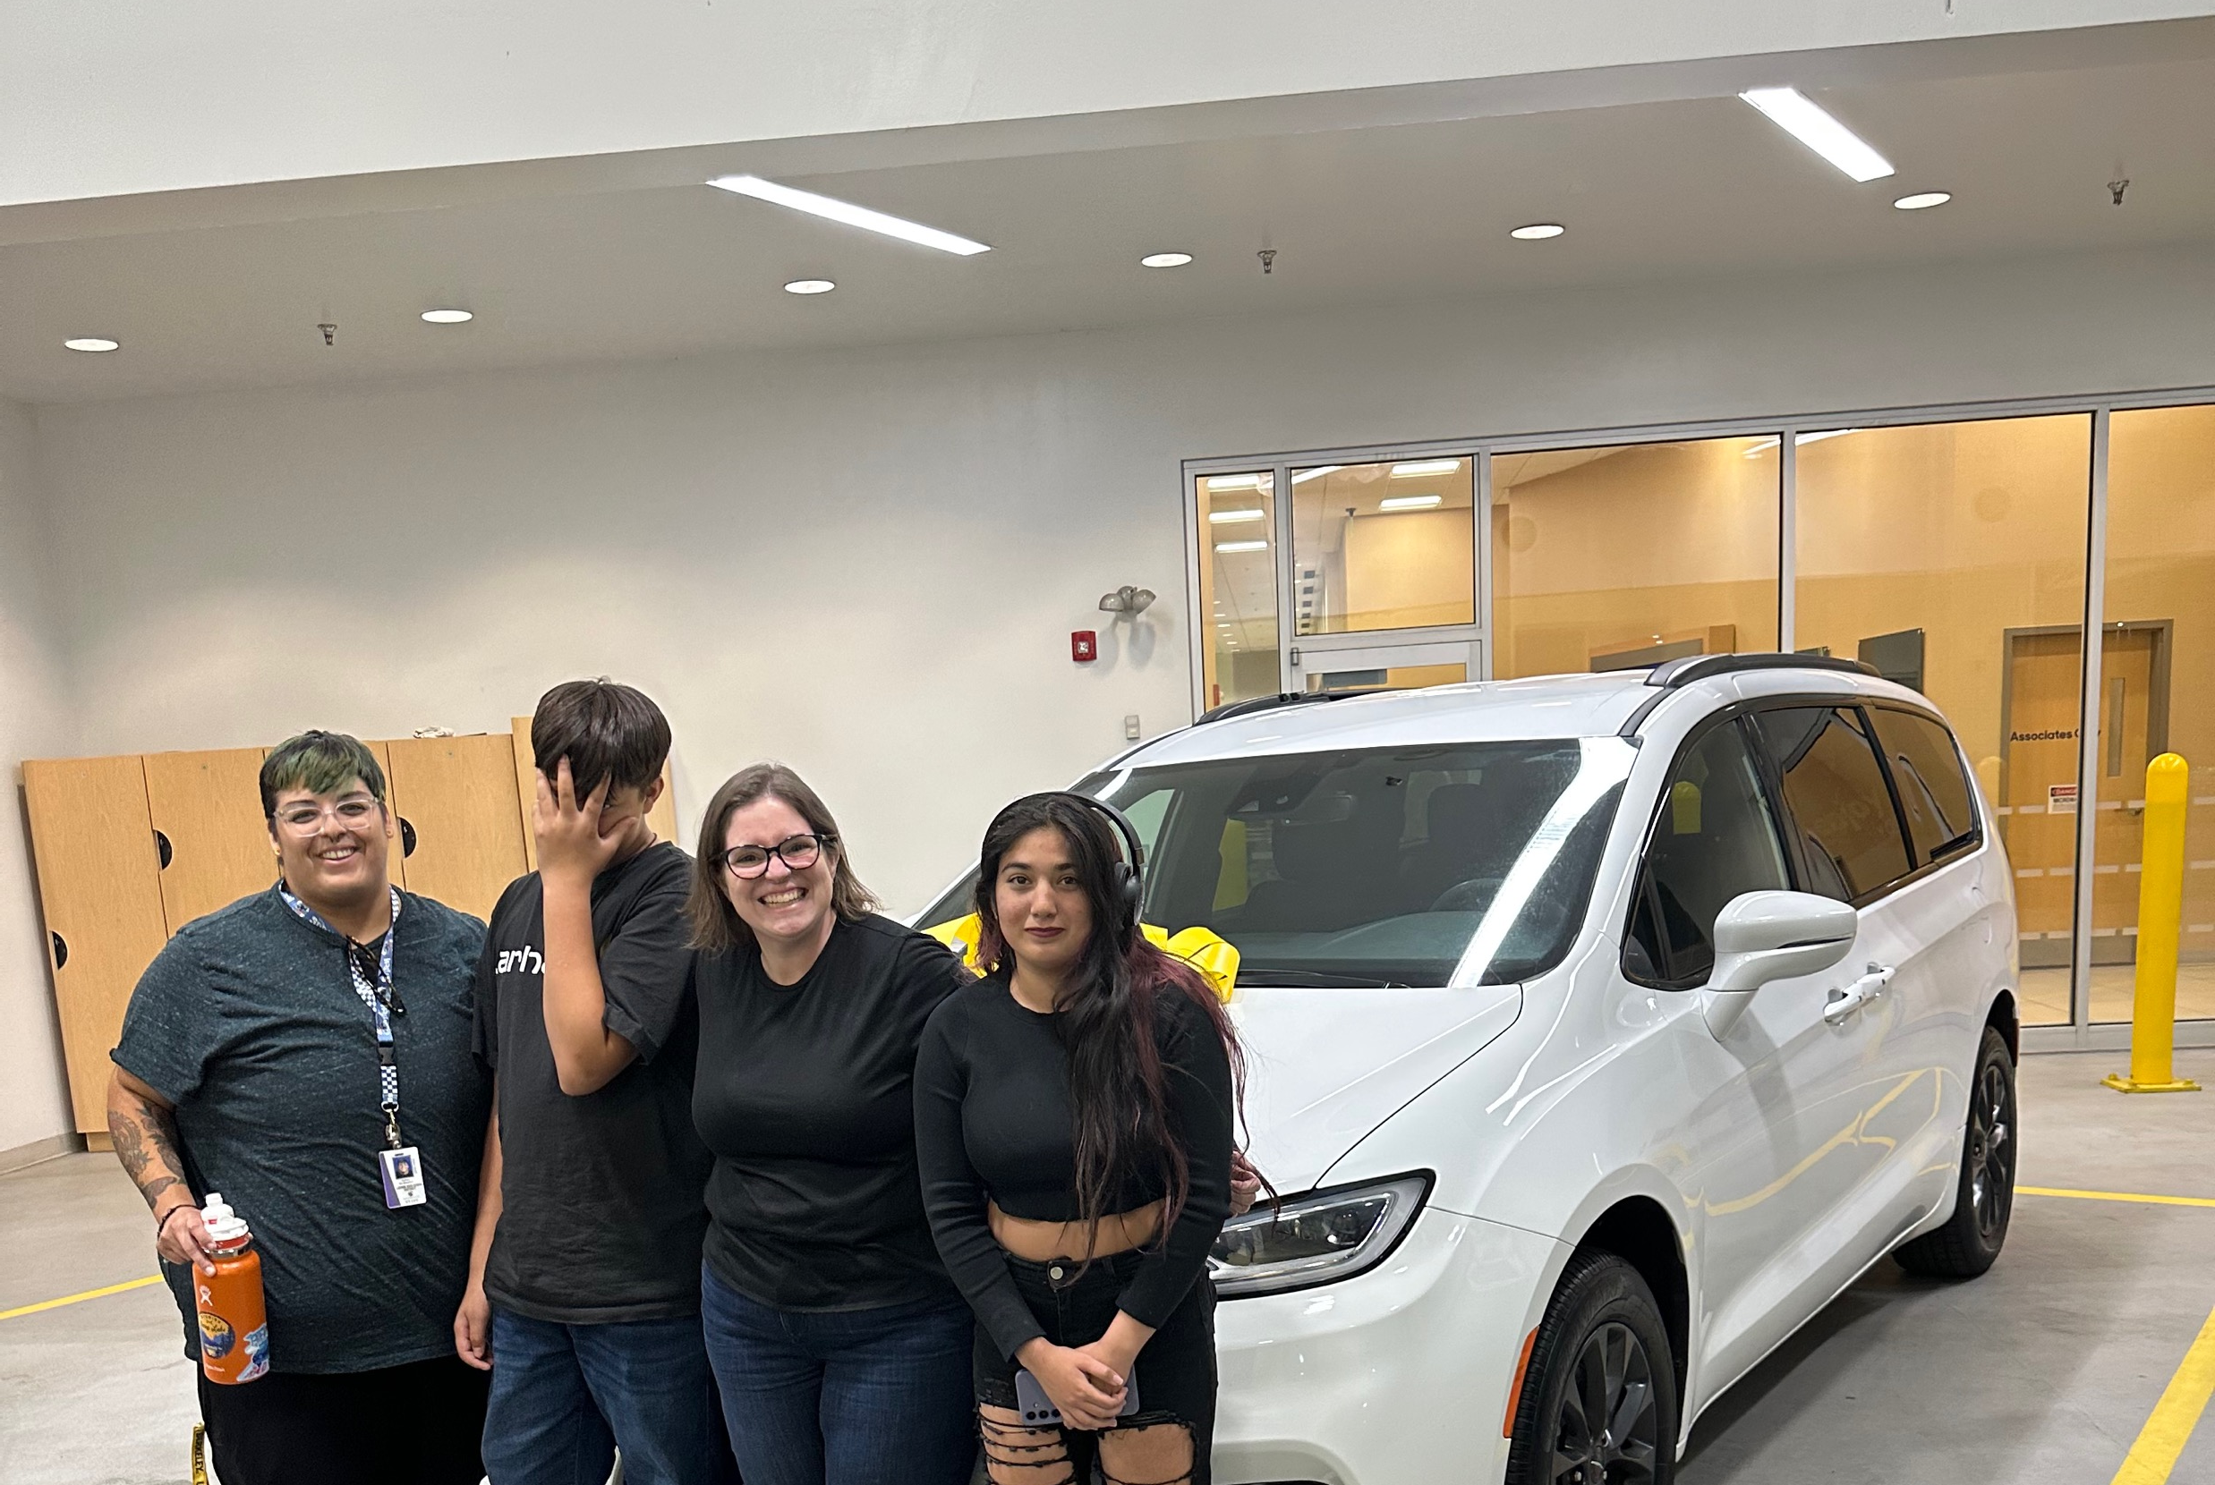
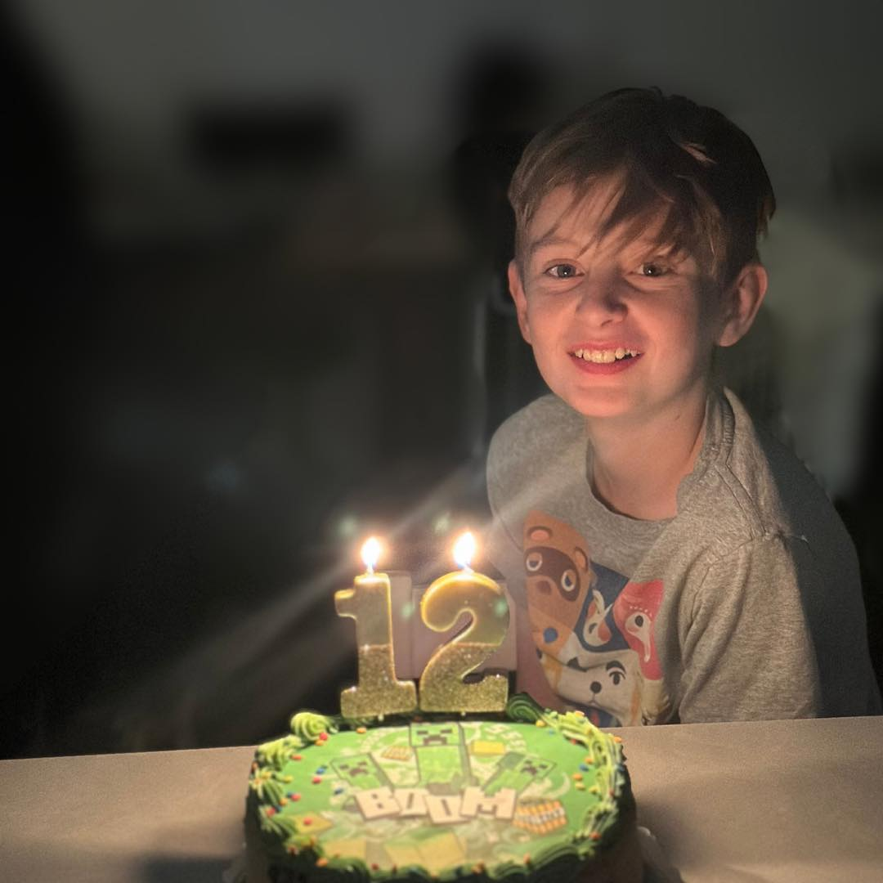
Facilitator
Katelyn McMeekin-Jackson, MA
Interim Leadership Development Specialist, California-Nevada Conference of The United Methodist Church

Slide 6

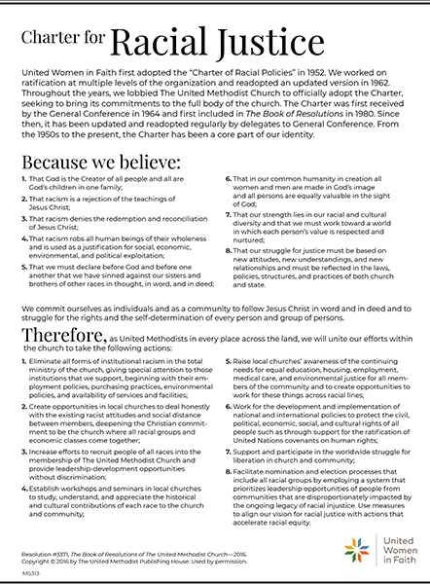
Cultural Competence Matters
In Business
In UWF
In the El Camino Real District
Because we believe: That in our common humanity in creation, all women and men are made in God’s image, and all persons are equally valuable in the sight of God

Slide 7
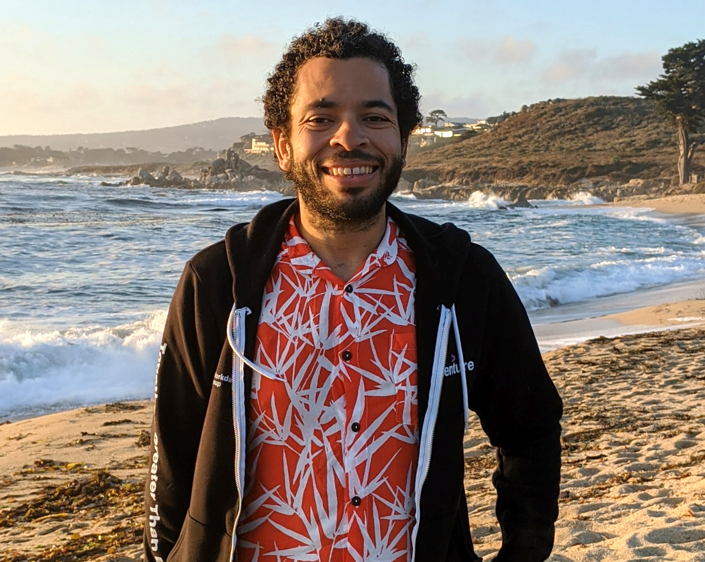
Focus on: El Camino Real District
Aton Abril, El Camino Real District Lay Leader

Slide 8
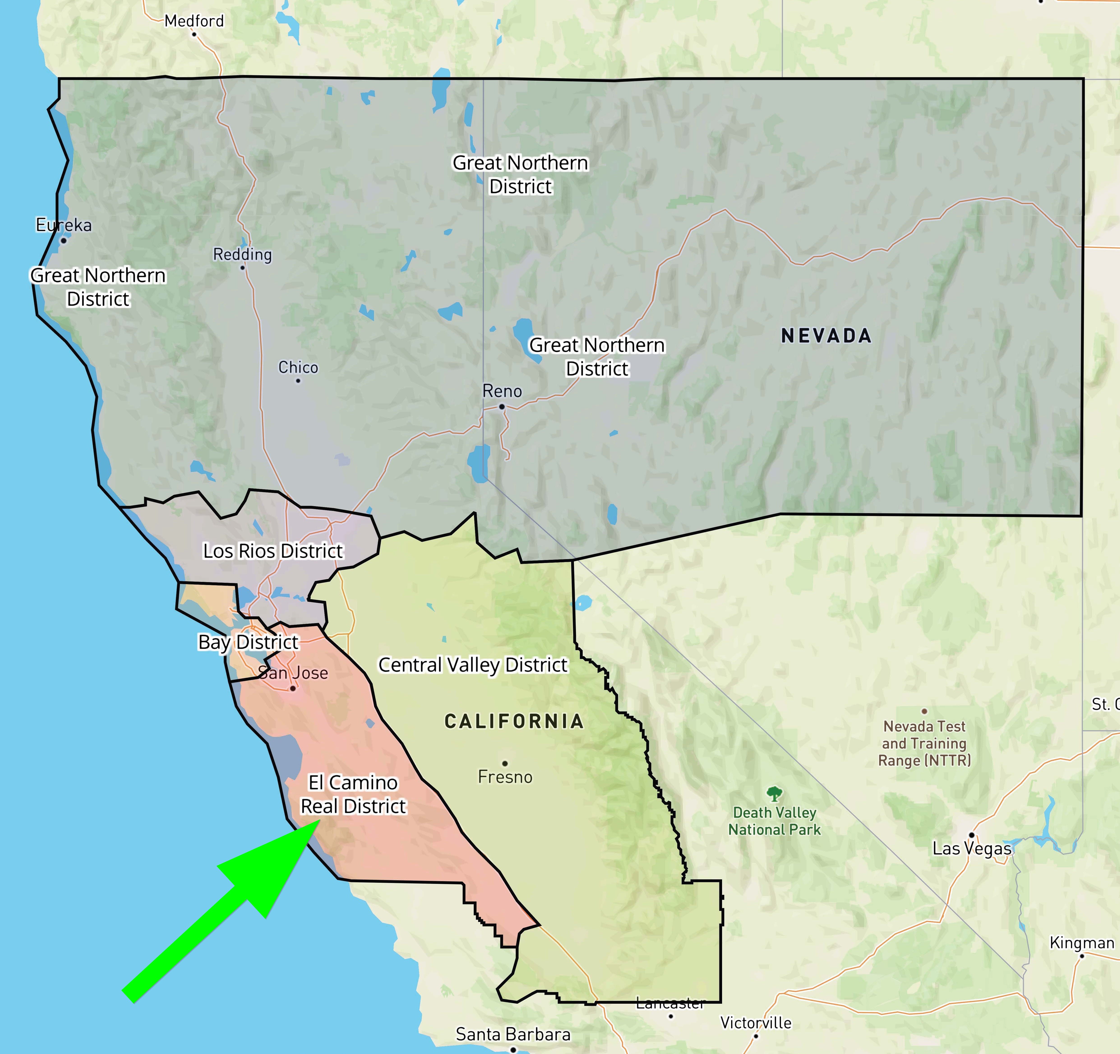
Where we are
50 churches

Slide 9
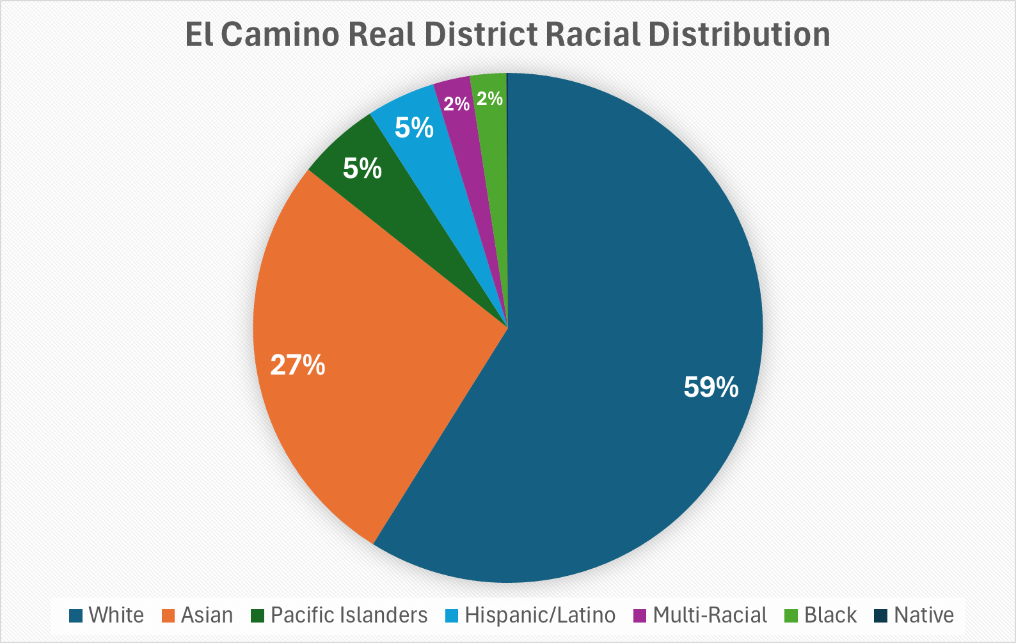
Who we are by the numbers
White | 6563
Asian | 2985
Pacific Islanders | 581
Hispanic/Latino | 487
Multi-Racial | 261
Black | 256
Native | 12
Notes:
To answer these questions, we want to share relevant knowledge and tools

Slide 10
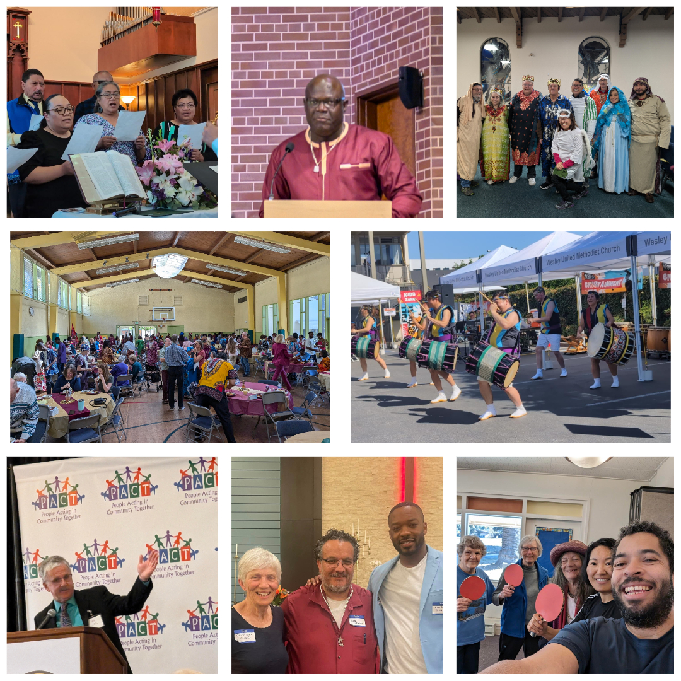
What's not in the numbers
Languages: English, Fijian, Hawaiian, Japanese, Korean, Mandarin, Spanish, Swahili, Tagalog, Tongan, Vietnamese
Notes:
To answer these questions, we want to share relevant knowledge and tools

Slide 11
How can we work well together
in cross-racial/cross-cultural settings?

Slide 12
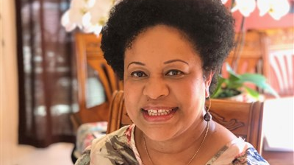
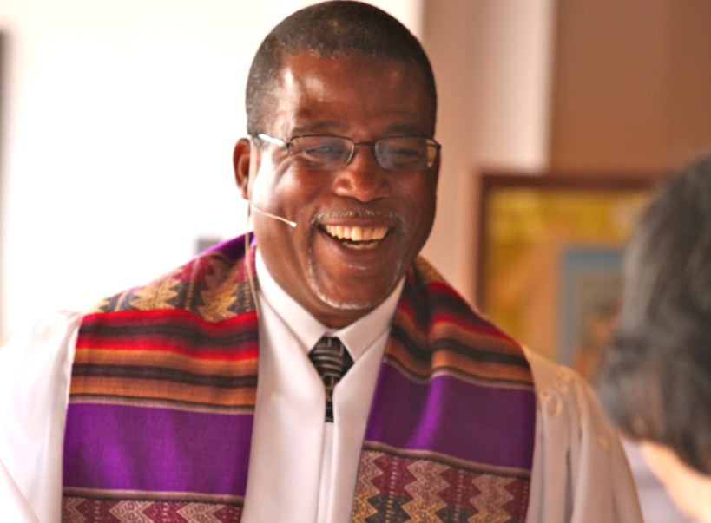
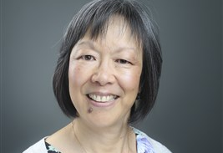
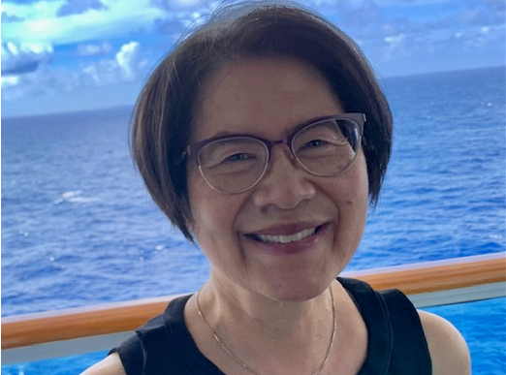
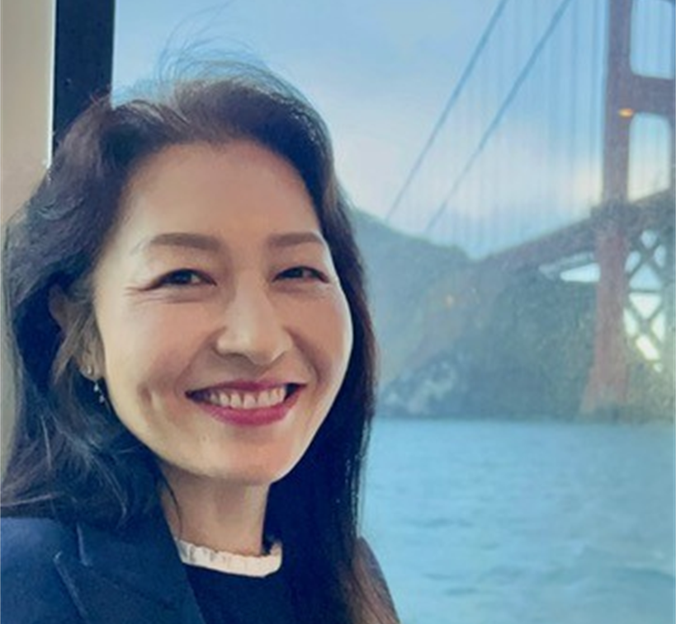
Cross-Racial/Cross-Cultural Ministry Team
Rev. Akesa Po’oi Fakava Pastor, Castro Valley UMC
Rev. Anne Choy Retired Clergy
Rev. Sun Hee Kim DS, Bay District
Rev. Dr. Dale Weatherspoon Pastor, Easter Hill UMC
Dr. Mary Cheng Retired Director, Leadership Development
Katelyn McMeekin-Jackson, MA Interim Leadership Development Specialist
Notes:
Joining me are Rev. Sun Hee Kim, DS of the Bay District and Rev. Dr. Dale Weatherspoon, Pastor of Easter Hill, UMC. Both are seasoned trainers with years of experience in the Intercultural field..

Slide 13
Objective
Share relevant knowledge and tools to help you
become more culturally self-aware
understand cultural differences
for the purpose of building life-giving relationships in intercultural contexts.
Notes:
To answer these questions, we want to share relevant knowledge and tools

Slide 14
Agenda
Definitions & Foundational Concepts
Cultural Humility & Agility
Three Images
Cultural Influences in Three Areas
Communication
Basis of Trust and Credibility
Leadership Orientation
Tools and Next Steps
Notes:
Our agenda begins with some definitions and foundational concepts then transition to examining cultural influences in three areas: communication, basis of trust, and leadership orientation.
Toward the end we will separate into Pastor and Laity breakout groups and have a talk back session and then close off with tools and next steps. We have much to cover and we hope you will stay engaged. We will have short stretch breaks throughout. So let us move to our definitions.

Slide 15

Goal 1: Cultural Humility
Self-aware — of our own assumptions and biases
Critical self-reflection
Empathy — taking the perspective of the other
Attuned— to power differences and how it shows up in relationships and interactions
Notes:
Imagine you are an immigrant; you have studied English in your home country but you did not have a chance conversation with a nature speaker, but your ability to read and write in English is very good, impeccable. You step into the doctor’s office. The attending nurse hardly looks up at you and starts asking questions. You are trying to catch what he is asking. You ask him to speak a bit slower. Instead the nurse starts to talk louder and louder. What do you think of this situation? Does this example resonate with some of your experience? Or you are a middle age woman and go into the doctor’s office; you tell your symptoms to the doctor and the doctor tells you it is all in your head.
The concept of cultural humility comes out of the healthcare field to help health care professionals become more conscious of their position and power, assumptions and prejudices when interacting with their clients ..
The focus is on understanding their clients on their own terms. The concept sets as a priority self-awareness, being able to be self-reflective concerning one’s own assumptions and biases. Also emphazised is empathy—being able to take on the perspective of the other; and a significant aspect is understanding how structures of power and privilege affect interpersonal interactions.

Slide 16
Cultural Humility
“Cultural humility involves an ongoing process of self-exploration and self-critique combined with a willingness to learn from others. It means entering a relationship with another person with the intention of honoring their beliefs, customs, and values. It means acknowledging differences and accepting that person for who they are.”
Cultural Humility vs. Cultural Competence - Soundscaping Source
Notes:
Here is a description of cultural humility … what is a word or phrase that catches your attention?

Slide 17
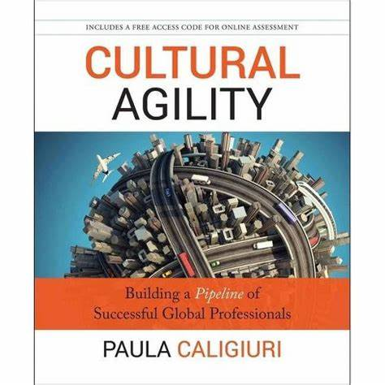
Goal 2: Cultural Agility
the ability to quickly, comfortably and effectively work in different cultures and with people from different cultures (Caligiuri, 2013)
Notes:
Paula Galigiuri is management professor in Northeastern University. She wears many hats, and one of them is researching skillsets or competencies required for professionals to be successful working in global teams withmembers coming from different cultural backgrounds. She defines cultural agility as the ability to quickly, comfortably and effectively work in different cultures and with people from different cultures. As CRCC pastors this is a tall goal, but Dr. Caligiuri thinks that it is possible to develop the mindsets and skillsets for being more comfortable and effective in different cultural settings.
In her research she uncovers 9 competencies; instead of going over all 9, I will focus on the last three which have to do with Task-Management.

Slide 18
Competencies (Mindsets and Heartsets)
Self-Management
Relationship-Management
Tolerance of Ambiguity: The ability to remain comfortable and effective in situations that are uncertain or unclear.
Curiosity: A strong desire to learn about and understand different cultures.
Resilience: The capacity to recover quickly from difficulties and adapt to new cultural environments.
Humility: Recognizing and valuing the perspectives and contributions of others.
Relationship-Building: The skill of forming and maintaining positive relationships across cultures.
Perspective-Taking: The ability to understand and consider the viewpoints of people from different cultural backgrounds.

Slide 19

Adaptation in Cultural Agility
“Know your role
Know your goal
Don’t lose your soul”
Beth Zemsky, Facilitating Cultural Change
To be adaptive does not mean sacrificing our own identity or values.
It does mean changing our approaches to yield positive outcomes.
It involves respecting others’ cultures and identities as well as our own.
Notes:
I want to return to adaptation because I hear some pastors saying, why do I always have to adapt? I don’t want to be inauthentic? Well, I like to highlight these 3 aspects:
Adaptation is not one-sided, such as the pastor always adapting to the congregation or the congregation always adapting to the pastor; it is a dance of mutuality. It is about respecting the cultures and identities of others as well as your own. As one of my instructors note when to adapt or not, Know your role, know your goal, don’t lose your soul.” So what is your role, your goal and what are your boundaries that you will not cross.

Slide 20

Dinner Table Breakout
Think back to your dinner table or how you ate your dinner as a child or youth. Draw a sketch of your dinner table on a sheet of paper.
On the paper, indicate who sat where?
How was dinner served? Who served?
What foods are on the table?
How were conversations conducted? (For example, children were to be silent)
Were their cultural aspects to the dinner (food, style of eating, manners)?
Share in your small groups of three, and we will bring you back in12 minutes.
Notes:
Close your eyes, think back Think back to your dinner table or how you ate your dinner as a child or youth. Draw a sketch of your dinner table on a sheet of paper.
Share your dinner table; each person gets about 4 min to share; stop watch, come back in 12 minutes.

Slide 21
Foundational Concepts & Tools
Notes:
I will go over 3 images or metaphors that can help us get a handle on culture and its influence on our thinking, feeling, and acting.

Slide 22
What is Culture?
At its deepest level, culture embodies the deeply held values that are not easily changed and that govern ways of thinking, acting, and resolving problems (Peterson and Spencer, 1990; Schein, 1992).
It reflects a “set of agreed upon expectations” and becomes what is considered “normal”

Slide 23
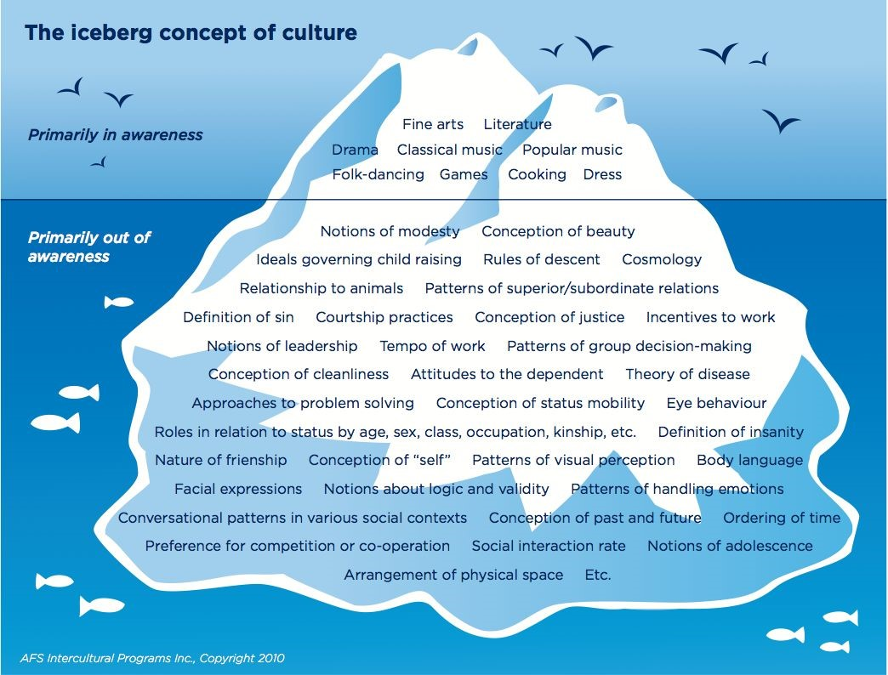
The Iceberg Concept of Culture
What is seen
What is unseen
Which is greater, above or beneath the waterline?
Notes:
This metaphor for culture illustrates that Much of our cultural values and expectations are out of our consciousness. The often used image of the iceberg is one way to capture the reality that only a small part of our cultural identity, our values, rises to the level of our consciousness (c. 15%) in the same way that only a small percentage of an iceberg is visible above the waterline. Most of our values and the beliefs are hidden from our own consciousness (c. 85%). They are out of view, “below our waterline.”
It is stunning to realize all these important values, these cultural expectations of ourselves and of others, lie outside of our consciousness – it is breathtaking!! Take a moment to let these sink into your brain, into your heart. Think about how these shape and give meaning to your life especially in relationships.

Slide 24

Cultural Lens important
We see the behavior.
We interpret that behavior according to our own cultural lens.
What often happens?
Notes:
Culture forms the lens that filter what we see in the world (perception) and how we understand it (interpretation) Becoming aware of our lens is the first step in intercultural work.

Slide 25
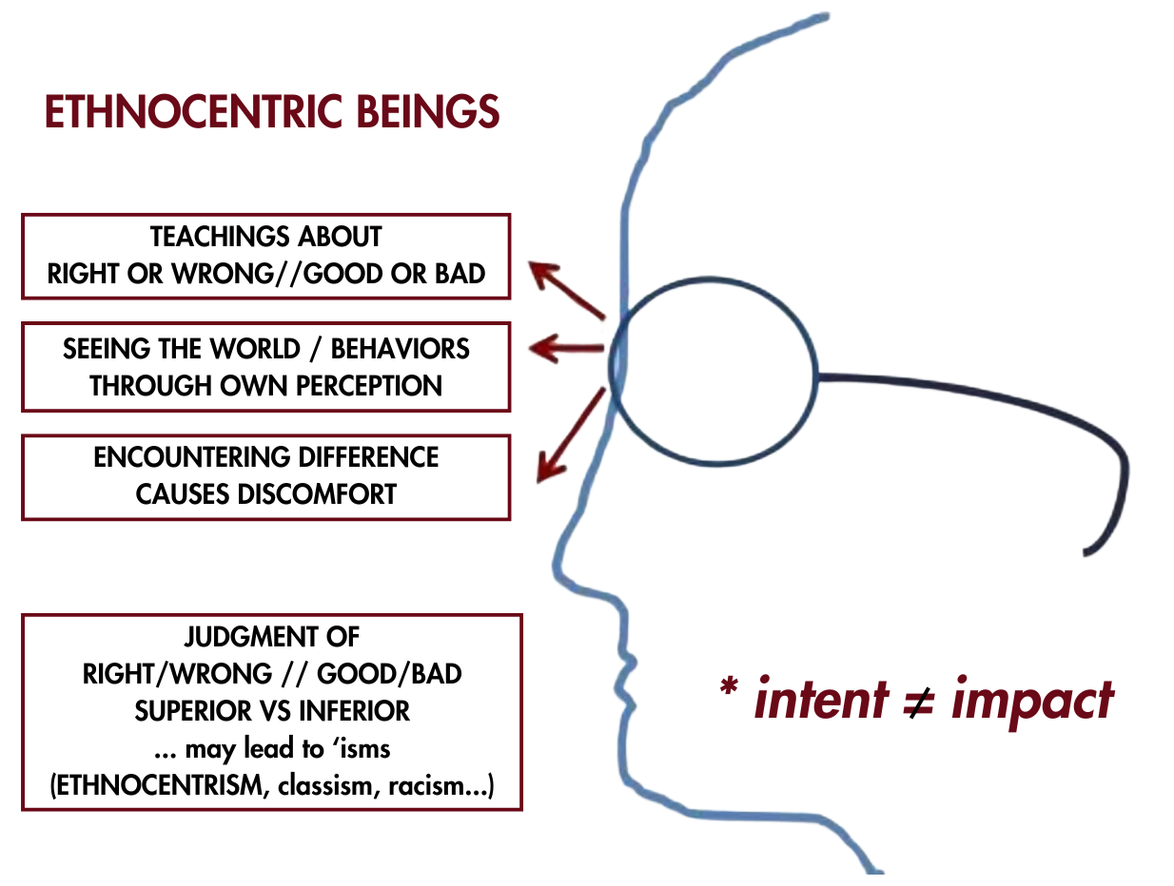
We are ethnocentric beings
Evaluate other peoples & practices according to our own cultural conditioning.
Notes:
Wearing our cultural lense we evaluate other peoples and practices according to our own cultural conditioning. This means that what we’ve been taught is used to interpret and judge things as good or bad, superior or inferior

Slide 26
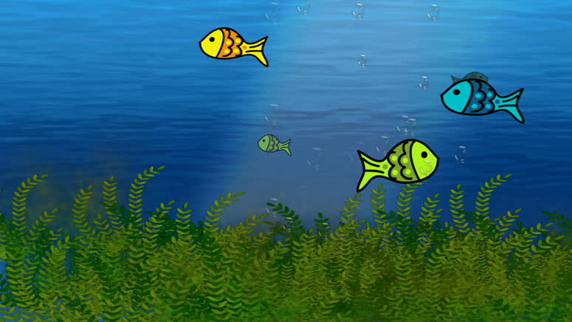
“Culture hides much more than it reveals, and strangely enough what it hides, it hides most effectively from its own participants. Years of study have convinced me that the real job is not to understand foreign culture but to understand our own.” Edward T. Hall
Notes:
Edward Hall, anthropologist and cross-cultural researcher observes that …

Slide 27
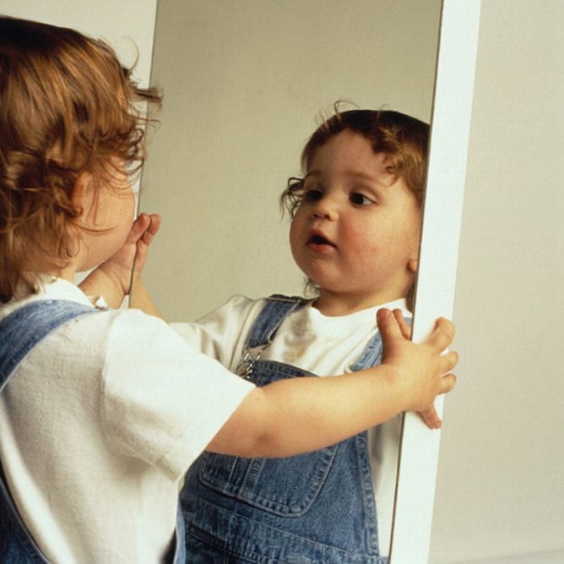
Mirror of Self-Awareness
“Knowing yourself is the beginning of all wisdom.”
Notes:
Hence, holding a mirror up to ourselves so that we can be more aware of our own cultural biases is a must. A common misconception: cultural awareness is learning about “the other.” If I can learn about the customs, values, and behaviors of other cultures, I’ll know how to act. Yes, learning about different cultures is a necessary and it is a second step. The first step is to be self-aware and understand that we are all ethnocentric beings.
Cultural awareness begins with understanding ourselves.

Slide 28
Cultural Influences in Three Areas
Communication: Direct/Indirect
Establishing Trust & Credibility:
Time & Task/Relationship
Leadership Orientation:
Egalitarian & Hierarchical

Slide 29
2 min- Stretch Break
Notes:
9:45

Slide 30
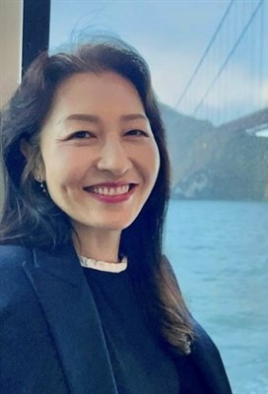
Communication
Pre-recorded message from DS Sun Hee Kim, Bay District

Slide 31
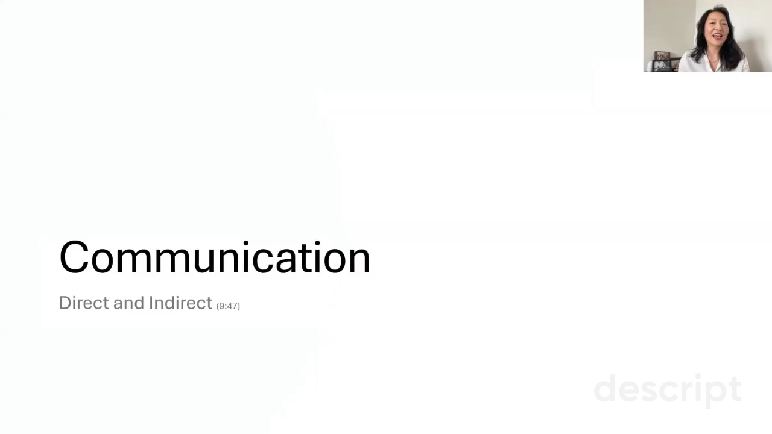

Slide 32
Break
Notes:
10:17

Slide 33
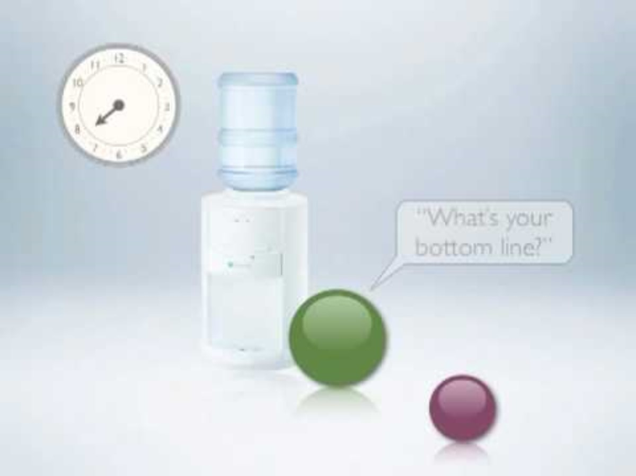
Video: Time Versus Relationship

Slide 34
Case Study
A local UWF unit has recently merged two groups - one predominantly white and one primarily Pacific Islander. They are working to function as one united UWF unit, and members from both groups serve on the Leadership Team.
The Leadership Team coordinator sends out the meeting agenda two weeks in advance, clearly noting start and end times for each meeting.
The Pacific Islander members are typically present in the church building before meetings but often gather in the fellowship hall to connect and catch up, arriving at the Leadership Team meetings about 15 minutes after the scheduled start time.
The members from the predominantly white group are becoming frustrated because they feel they need to repeat information for late arrivals, and meetings frequently run over the scheduled end time. The Leadership Team coordinator has approached the Conference UWF leadership for guidance on addressing this cultural difference while maintaining unity in their unit. What would you advise?
Notes:
How can we adopt a mindset of cultural humility?
What are the values of each community?
What could be an adaptive response from each community?
What overarching goal is being served when there is mutual adaptation?
As a church, are we not sharing life and work together?

Slide 35
Breakout Rooms
Please discuss the following three questions:
Where is the iceberg crash?
What does "polite" look like?
What advice would you give to the group?

Slide 36
Understand the Basis of the Conflict: “Under the Waterline” Values – how would you "fix"? Where is the iceberg crash? What does "polite" look like?
Euro-American Council Members
Pacific Islander Council Members

Slide 37
Understand the Basis of the Conflict: “Under the Waterline” Values – how would you "fix"? Where is the iceberg crash? What does "polite" look like?
Euro-American Council Members
Pacific Islander Council Members
Respect for people's time
Task orientation
Prioritizing organization as corporation/business
Relationship orientation
Relationship building
Wanting to make sure everyone is included in decision-making
Spending time with family

Slide 38
Establishing Trust
Orientation Toward Time/Task versus Relationships

Slide 39
Toward a Solution: Adopting a Cultural Humility Mindset
"A Third Way"
 | Euro-American Council Members | Pacific Islander Council Members
Adaptive Responses | Put check-in on the agenda Fellowship time in advance of the start of the meeting Reframing fellowship time as essential, not optional – not understanding someone's context makes it difficult to work together Focus on patience: everything doesn't have to be a rush! | Ask a trusted bridge person from the community to speak to the need and benefit to start the meeting on time and if late, someone else will brief you etc Join in creating the agenda
Gospel Values | Kindness: allowing people to get home to their families "Good Stewards" in how we care for the church | Relationship Fellowship Jesus magnified that we are one body
Notes:
Adopting a mindset of cultural humility
What could be an adaptive response from each community?
What gospel values can encourage us toward mutual adaptation or finding a third way?
As a church, are we not sharing life and work together?

Slide 40
View of Leadership
Authority and Decision-Making (10:45)

Slide 41
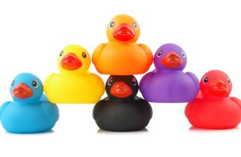



Leadership in more hierarchical cultures
Leadership in more egalitarian cultures

Slide 42
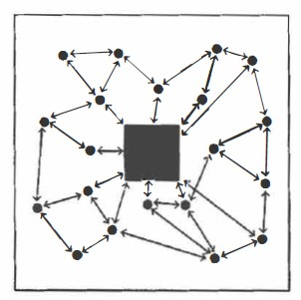
Egalitarian Cultures: Authority & Decision-Making:
Everyone is somewhat equal unless there is expert in the room
Everyone can exchange ideas; dialogue is important
Decision-making by consensus or voting
Leader’s decision can be questioned
Pastor is like a facilitator or a band leader
Respect is earned through job performance.

Slide 43

Hierarchical Cultures: Authority & Decision-Making
People are comfortable in unequal status relationship
Deference to the leader. The leader is not challenged directly
Position, titles, and status markers are important
Maintaining relationships is more important than completing a task
Authority and respect based on the role

Slide 44
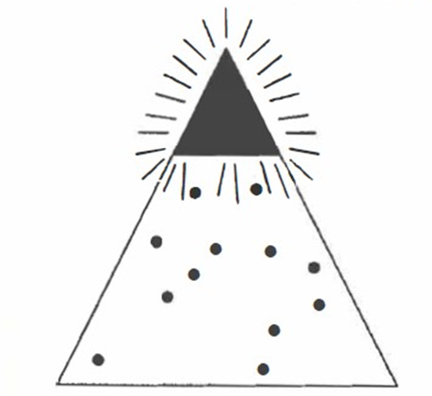
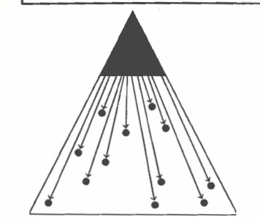
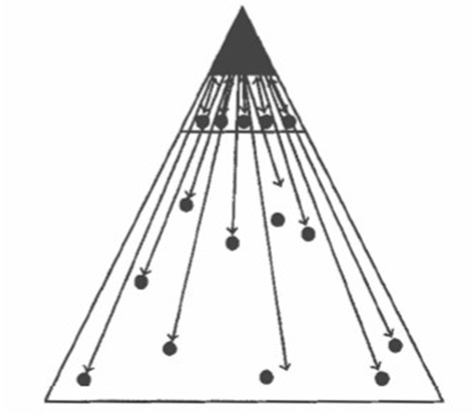
Pastoral Leadership: Three models of Hierarchical Leadership
Pastor
Pastor
Pastor
Small group
of leaders
People
People
People
Hierarchical #1: Simple
Hierarchical #2: Chain of Command
Hierarchical #3: Spiritual Presence

Slide 45
When leadership expectations differ
Local UWF President Sarah has moved from Atlanta to suburban Minneapolis to be closer to her daughter's family and is now leading a predominantly white suburban unit with a long history of community service. Sarah's background is with an urban African American UWF unit where the president traditionally takes a strong leadership role. She's accustomed to working closely with her executive committee to develop and implement mission initiatives, with her providing primary direction for the unit's vision.
The Minneapolis suburban unit, however, has many active members involved in various mission projects but operates with a more distributed leadership style. She was told that different circle leaders and committee chairs manage their own areas independently, and the unit has historically functioned through collaborative decision-making rather than top-down direction. Sarah feels uncertain about how to effectively lead while honoring the unit's existing culture of shared leadership, especially as she's still adjusting to both a new region and a different leadership dynamic.

Slide 46
Case Analysis
What is Pastor Sarah's leadership orientation?
What is the unit's orientation?
What would you suggest as a way forward for Pastor Sally and the church?

Slide 47
Intentional Positive Interactions to find a Third Way
Establish a Shared Purpose that is meaningful to those involved
Build trust and confidence in your leadership and in the team through integrity
Foster frequent and meaningful interactions and opportunities for engagement
Create an environment where everyone feels comfortable in sharing their perspectives without fear
Ensure equal participation – that all voices are heard (no one dominates)
Challenge assumptions, biases, and explore new ideas to foster innovation
“From Diversity to Inclusion to Equity: A Theory of Generative Interactions” by Ruth Sessler Bernstein, Morgan Bulger, Paul Salipante, and Judith Y. Weisinger
Notes:
In a broader theoretical context, third space theory, introduced by Homi K. Bhabha, describes a hybrid space where different cultures and identities interact and blend, creating new, unique cultural expressions³.

Slide 48
RESPECTFUL COMMUNICATION GUIDELINES
R = Take RESPONSIBILITY for what you say and feel without blaming others
E = Use EMPATHETIC listening
S = Be SENSITIVE to differences in communication styles
P = PONDER what you hear and feel before you speak
E = EXAMINE your own assumptions and perceptions
C = Keep CONFIDENTIALITY
T = TRUST ambiguity because we are not here to debate who is right or wrong
S = SHARE your air-time: Step Up, Step Back
RESPECTS: The ability to communicate esteem for persons from other cultures and other racial/ethnic identities
Notes:
9:15-9:20

Slide 49
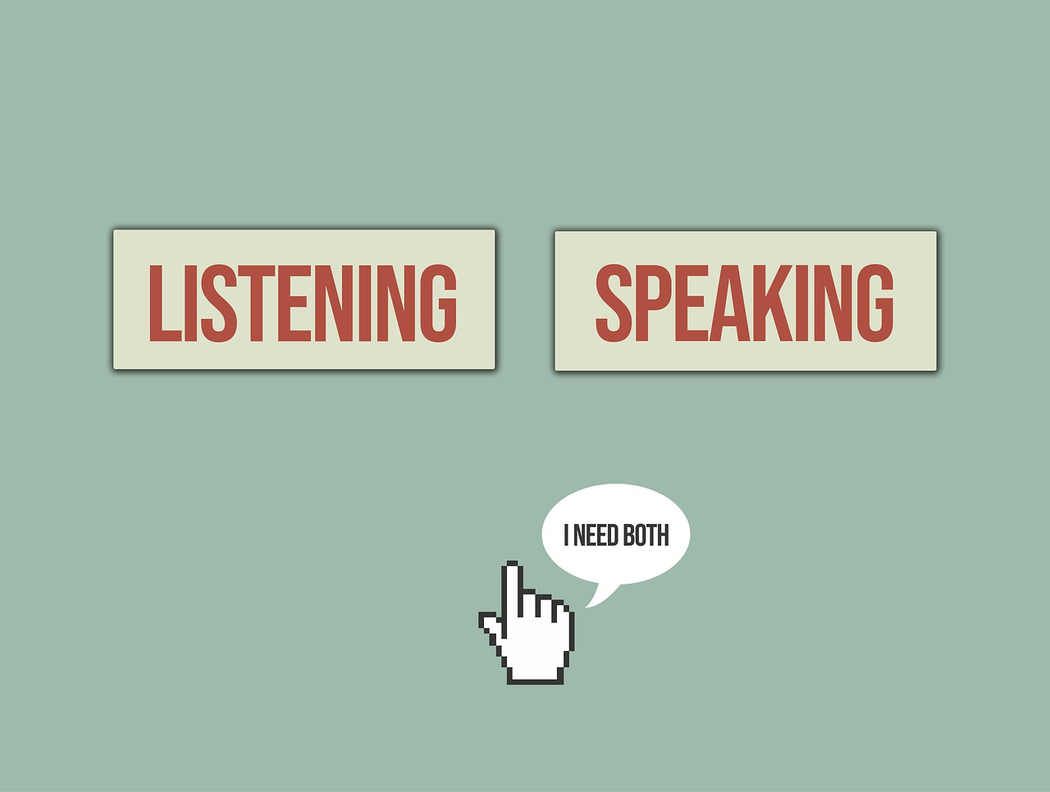
Mindful of your airtime
Step up if you are normally quiet
Step back if you are normally the first ones to speak

Slide 50
Standardize (no adaptation) | Mutual Adaptation or Integration/A Third Way
Legal Requirements | Worship
Safe Sanctuary | Ministry
Fiscal Integrity | Communication
Checks & Balances (Book of Discipline) | Outreach
Notes:
Competency
Definition
Cultural Minimization
To standardize or control the cultural differences that exist in the environment and respond in a way that will create greater consistency, irrespective of culture. To effectively limit the effect of any cultural differences.
Cultural Adaptation
To adjust to the cultural differences and respond in a way that is the expected norm of the other culture. To effectively adapt to the other culture’s norms and behaviors.
Cultural Integration
To create a new set of norms and respond with collaboration to find solutions acceptable to both (or all) cultures affected, but not overrepresenting either (or any one) culture. To be effective in creating new norms and behaviors.

Slide 51
5 min- Break
Notes:
10:15

Slide 52
Tae: what does a multi-cultural church look like?

Slide 53
Tools
Mindsets and Skillsets Toward Developing Cultural Humility & Agility
Notes:
Iceberg, Lens, Mirror

Slide 54
Disrupt Bias and Rapid Judgment
Slooooow Down
Breathe
Attribute good intentions
Be curious—learn about different cultures

Slide 55
Next Steps
Individuals:
You’re invited! Small Group Cohort for SPRC and laity leaders to further discuss Cross-Cultural Ministry
Sign up for a six-module online course on Intercultural Competence; each course is approximately 20-30 minutes.
Take the Intercultural Development Inventory: Conference resource ($40) that provides an Individual Development Plan
UWF Units:
Intercultural Development Index for groups
Lean into being a guest; l
Be a follower, especially of people of color
Solidarity with the Sojourners – Monday at 4 PM Pacific https://www.resourceumc.org/en/content/solidarity-with-the-sojourners
Summer African American/Black Methodist Summit
Attend cultural events in your district
Stay tuned for more cultural events
Notes:
If interested email me

Slide 56

Thank you
Be blessed as you go forth

